Slide 1


FRE7043 Capstone
Project Presentation: Bollinger Band Trading Strategy
By
Zicheng He
2020-12-08

Slide 2
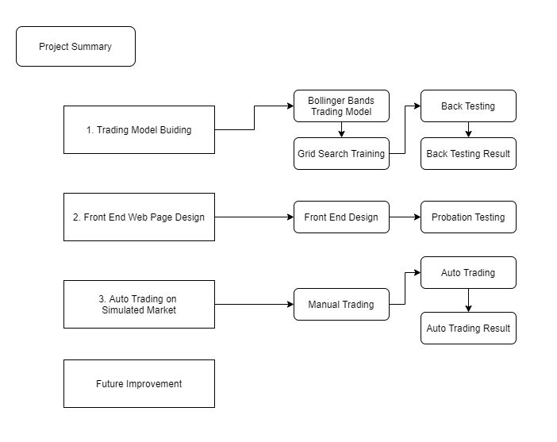
1. Project Summary

Slide 3
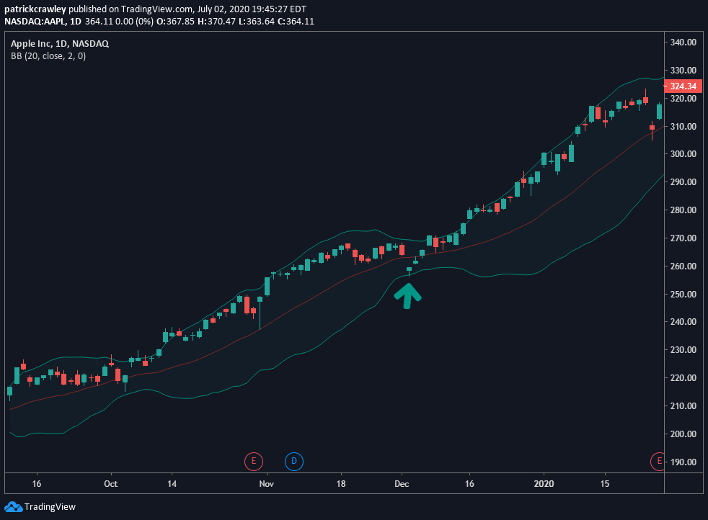
2. Trading Logic
Red line: The H-period SMA. This serves as both the center of the BBs, and the baseline for determining the location of the two bands. The upper or lower band line that is k1 (default is 2) standard deviation from the H-minute SMA
Open Trades: • Open short position if Price >= Upper Band, sell the stock • Open long position if Price <= Lower Band, buy the stock
Close Trades: • Close the open positions when Price return within Up and Down

Slide 4
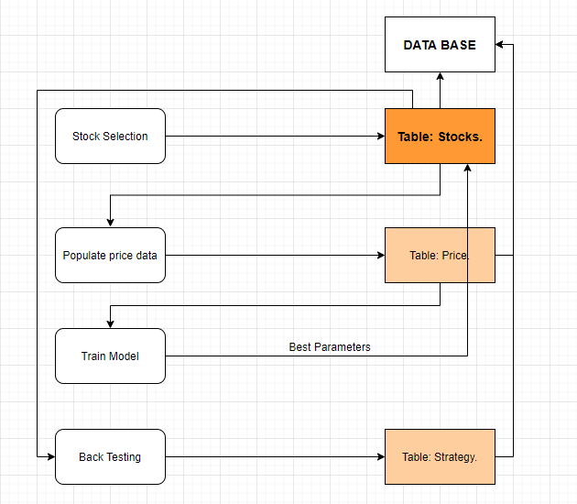
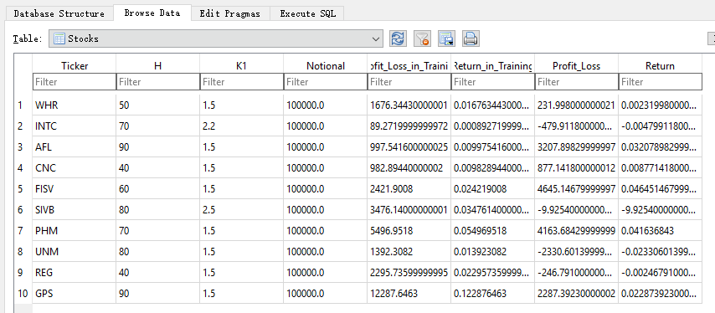
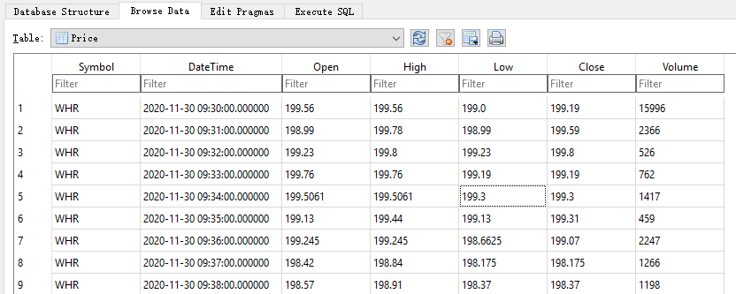
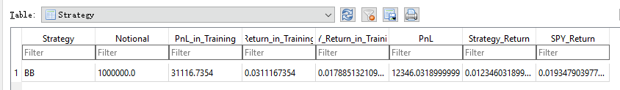
3. Market Data Feed and Database

Slide 5
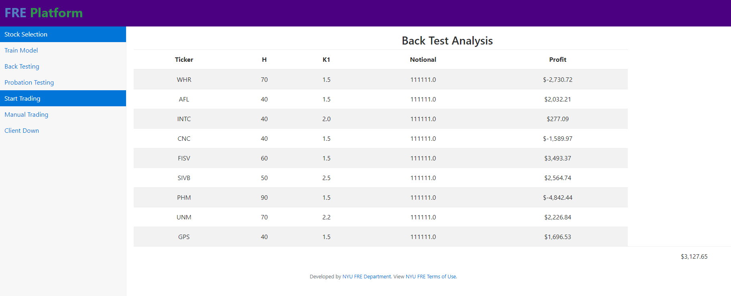
4. Back Testing
Training period: 1 week before the recent 1 week, i.e, 11.21 – 11.28.
That is because for the recent week (11.29 - 12.6), it is used for back testing and we don’t want our training period and back testing period to overlap.
Reason: 1- min data, Parameters are short-memory.

Slide 6
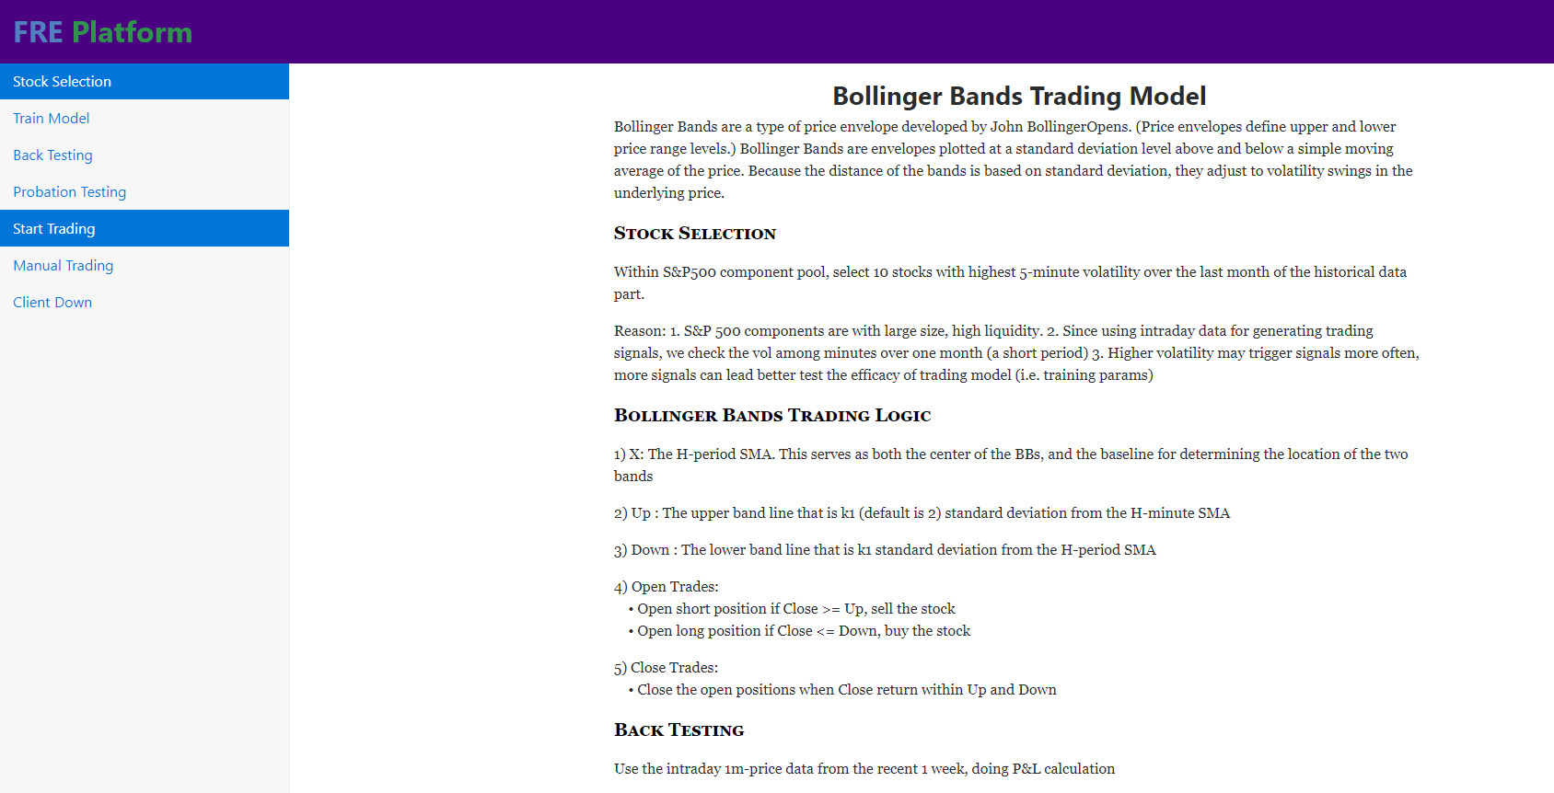
5. Front End Design in Build Model
Stock Selection
Train Model
Back Testing
Probation Testing

Slide 7
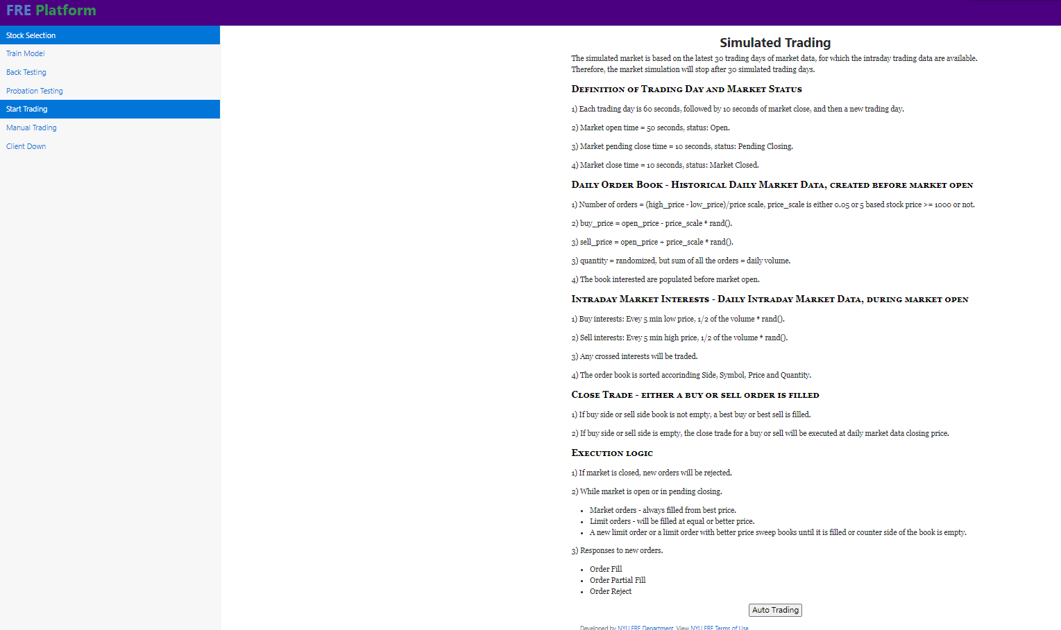
6. Front End Design in Auto Trading
Start Trading -> Auto Trading
Auto Trading Result -> Analysis
Manual Trading
Client Down

Slide 8
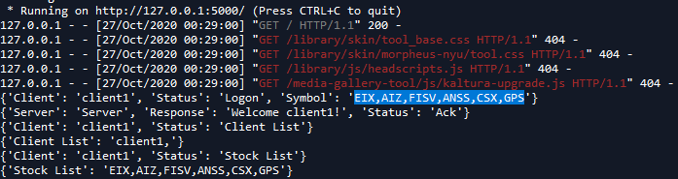
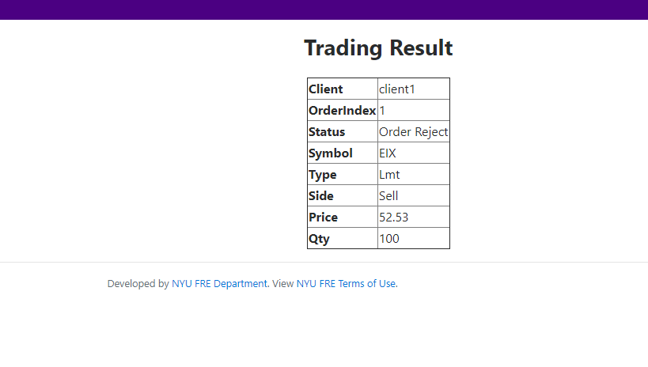
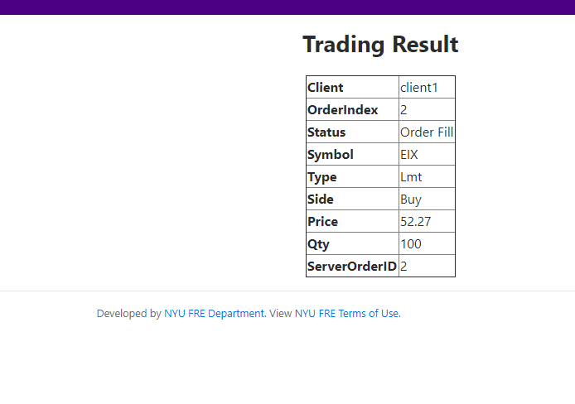
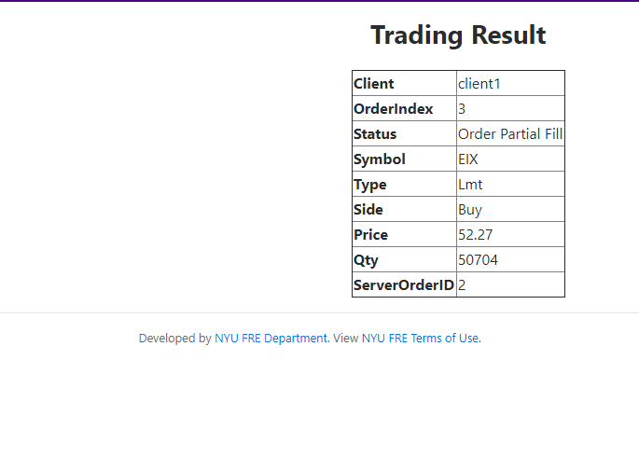
7. Manual Trading
Purpose: to get familiarize with the client side and server-side connection
2. Three Different Responses:

Slide 9
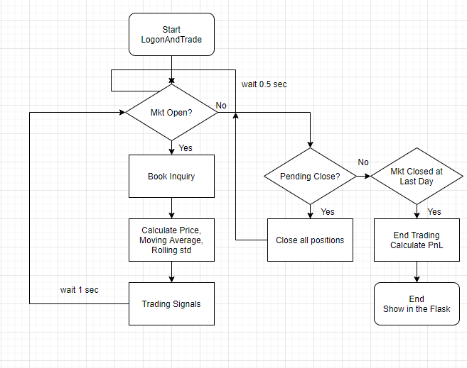
8. Trading on Simulated Market
Auto Trading Flow Chart:

Slide 10
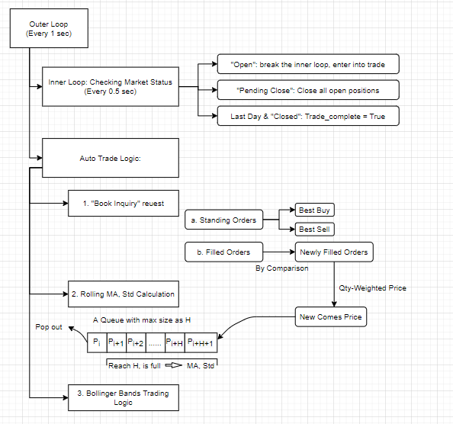
8. Trading on Simulated Market (con.)
The whole process in detail:

Slide 11
9. Movie Demo
Steps:
Part1. Stock Selection, Train Model, Back Testing, Probation Testing, Database Presenting.
Part2. Auto Trading, Auto Trading Result & Analysis Page, Client Down.

Slide 12
10. Future Improvement
1. Parameters Training
The PnL may be good for the recent week, however, if we need to further prove it is profitable, we need to run it on other periods. That is because the profitability of the model is quite time-varying and the parameters we train are quite short-memory.
To Try: Train the params on a rolling basis, test the model on 4 single weeks following the training period.
2. Auto Trading Analysis Page
The current Analysis page only separate the PnL to each stock.
To Do: Performance statistics calculated in trade level. For instance, Sharpe ratio, Information ratio, Win ratio, etc. We can even plug in PnL graphs into the page, can also show buy and sell points.
3. Auto Trading Logic
Since we use timer in our program to pull order book every second, sometimes we cannot enter the right price that we want to trade.
To Try: We may find way to make our calculation process faster. Or we should make the time interval to be longer, in order to make sure our process finished before the update of order book.

Slide 13
Reference
Reference:
1. John Bollinger, Bollinger On Bollinger Bands
2. Miguel Grinberg, Flask Web Development: Developing Web Applications with Python
3. Richard Stevens, UNIX networking programming
4. Anthony Williams, C++ Concurrency in Action

Slide 14
Thank You.
Zicheng He
2020-12-08

